Slide 1
Computer Network

Slide 2
Protocol
A protocol is a set of rules and standards that primarily outline a language that devices will use to communicate.

Slide 3
The Open System Interconnection (OSI) reference model describes how the information moves from one computer to another computer through a network.
This model was developed by the International Organization for Standardization (ISO) in 1984.
This model is used for understanding and designing a network architecture that is flexible, robust and inter-operable.
OSI model has seven separate but related layers : Physical, Data link, Network, Transport, Session, Presentation and Application.
Each layer defines a part of the process of moving information across the network.

Slide 4
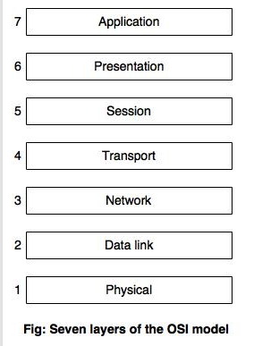

Slide 5
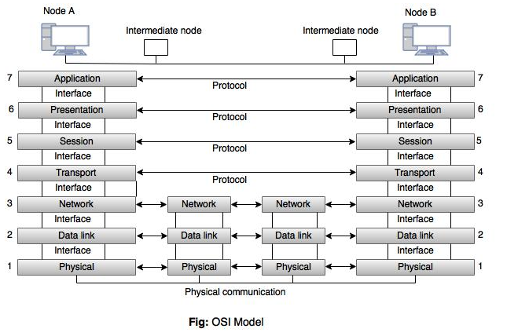

Slide 6
1. Physical layer
Physical layer is the lowest layer of the OSI model.
It coordinates the function required to transmit a bit stream over a communication channel.
It defines the procedures and functions that physical devices and interfaces have to perform for transmission.
Physical layer also defines the direction of transmission between two devices. Direction may be simplex, full-duplex and half-duplex.

Slide 7
2. Data link layer
Data link layer is responsible for transmitting the data over the channels.
It is used to divide the stream of bits received from the network layer into manageable data units called frames.
It adds a header to the frame to define the sender and receiver of the frame.
Data link layer detects and corrects the transmission errors using the correction method.

Slide 8
3. Network layer
The network layer is responsible for the delivery of a packet, across multiple network.
It specifies the intra-network operations and different types of addressing and routing devices.
Network layer also provides the logical and service addressing and switching control.

Slide 9
4. Transport layer
The transport layer specifies the process to process delivery of the entire message.
It is responsible for flow control and error control.
The transport layer of sending device makes sure that the entire message arrives at the transport layer of receiving device without error

Slide 10
5. Session layer
Session layer is the network dialog controller.
It is used to establish, maintain and synchronize the interaction among communicating system.
Specific responsibility of session layer is dialog control.

Slide 11
6. Presentation layer
The presentation layer is responsible to translate the information in to bit streams before transmission.
It is also responsible for data encryption, data decryption and data comprehension.

Slide 12
7. Application layer
Application layer allows the user, whether human or software, to access the network.
This layer provides user interfaces and application services for file transfers, e-mail, and other network software services.

Slide 13
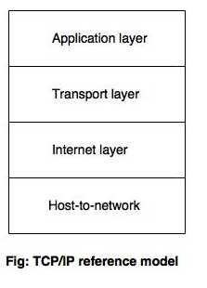
TCP/IP Model

Slide 14
TCP/IP Model
TCP/IP means Transmission Control Protocol / Internet Protocol.
TCP/IP model is a four layer model and the layers are host-to-network layer, Internet layer, transport layer and application layer.
The three topmost layers (application, presentation and session) in the OSI model are represented in TCP/IP by a single layer called the application layer.
The host-to-network layer in the TCP/IP model is equivalent to the combination of physical and data link layer in the OSI model.

Slide 15
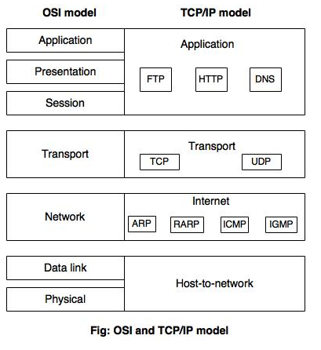

Slide 16
Host-to-network
Host-to-network layer does not define any specific protocol.
It supports all the standard protocols.
It is responsible for accepting and transmitting IP datagrams.
The TCP/IP network can be a Local Area Network (LAN) or a Wide Area Network (WAN).

Slide 17
Internet layer
At the Internet level, TCP/IP supports IP, ARP, RARP, ICMP and IGMP protocols.
All these protocols handle machine to machine communication. IP – IP is the primary protocol, which is used to transport data in packets (datagrams). Each packet is transported separately. ARP – The Address Resolution Protocol is used to associate a logical address with a physical address. RARP – The Reserve Address Resolution Protocol is used to discover host's Internet address when it knows only its physical address. ICMP – The hosts and gateways use the ICMP (Internet Control Message Protocol) mechanism to send notification of datagram problems back to the sender. IGMP – The Internet Group Message Protocol is used for simultaneous transmission of a message to a group of recipients.

Slide 18
Transport layer
UDP and TCP are the transport layer protocols.
These protocols are responsible for delivery of a message from one process to another process. TCP – TCP converts the incoming data stream into smaller units called segments and passes each one into the internet layer. UDP – This is a connectionless protocol. It adds only port address, checksum error control and length information to the data from the upper layer.

Slide 19
Application layer
The application layer protocols are: SMTP, FTP, HTTP, DNS, SNMP TELNET and so on.
TELNET is the Network Terminal Protocol, which provides remote login over the network.
SMTP is used to deliver the electronic mail.
FTP is used for interactive file transfer.

Slide 20
Transmission Mode
The way in which data is transmitted from one device to another device is known as transmission mode.
The transmission mode is also known as the communication mode.
Each communication channel has a direction associated with it, and transmission media provide the direction. Therefore, the transmission mode is also known as a directional mode.
The transmission mode is defined in the physical layer.

Slide 21
The Transmission mode is divided into three categories:
Simplex mode
Half-duplex mode
Full-duplex mode

Slide 22
Simplex Mode
In Simplex mode, the communication is unidirectional, i.e., the data flow in one direction.
A device can only send the data but cannot receive it or it can receive the data but cannot send the data.
The radio station is a simplex channel as it transmits the signal to the listeners but never allows them to transmit back.
Keyboard and Monitor are the examples of the simplex mode as a keyboard can only accept the data from the user and monitor can only be used to display the data on the screen.

Slide 23
Advantage of Simplex mode:
In simplex mode, the station can utilize the entire bandwidth of the communication channel, so that more data can be transmitted at a time.
Disadvantage of Simplex mode:
Communication is unidirectional, so it has no inter-communication between devices.

Slide 24
Half Duplex Mode
In a Half-duplex channel, direction can be reversed, i.e., the station can transmit and receive the data as well.
Messages flow in both the directions, but not at the same time.
The entire bandwidth of the communication channel is utilized in one direction at a time.
In half-duplex mode, it is possible to perform the error detection, and if any error occurs, then the receiver requests the sender to retransmit the data.
A Walkie-talkie is an example

Slide 25
Advantage of Half-duplex mode:
In half-duplex mode, both the devices can send and receive the data and also can utilize the entire bandwidth of the communication channel during the transmission of data.
Disadvantage of Half-Duplex mode:
In half-duplex mode, when one device is sending the data, then another has to wait, this causes the delay in sending the data at the right time

Slide 26
Full-duplex mode
Full duplex mode, the communication is bi-directional, i.e., the data flow in both the directions.
Both the stations can send and receive the message simultaneously.
Full-duplex mode has two simplex channels. One channel has traffic moving in one direction, and another channel has traffic flowing in the opposite direction.
The Full-duplex mode is the fastest mode of communication between devices.
The most common example of the full-duplex mode is a telephone network. When two people are communicating with each other by a telephone line, both can talk and listen at the same time.

Slide 27
Advantage of Full-duplex mode:
Both the stations can send and receive the data at the same time.
Disadvantage of Full-duplex mode:
If there is no dedicated path exists between the devices, then the capacity of the communication channel is divided into two parts.

Slide 28
Connection less and connection Oriented service
Data communication is a telecommunication network to send and receive data between two or more computers over the same or different network.
There are two ways to establish a connection before sending data from one device to another, that are Connection-Oriented and Connectionless Service.
Connection-oriented service involves the creation and termination of the connection for sending the data between two or more devices.
In contrast, connectionless service does not require establishing any connection and termination process for transferring the data over a network.

Slide 29
Connection-Oriented
Connection is established.
Information is sent.
Connection is released.

Slide 30
Connectionless Service
It is similar to the postal services
Carries the full address of destination.
It is not a reliable network service because it does not guarantee the transfer of data packets to the receiver, and data packets can be received in any order to the receiver.
Data packet does not follow a defined path.
In connectionless service, the transmitted data packet is not received by the receiver due to network congestion, and the data may be lost.
Example of Connectionless service is UDP (User Datagram Protocol) protocol.

Slide 31
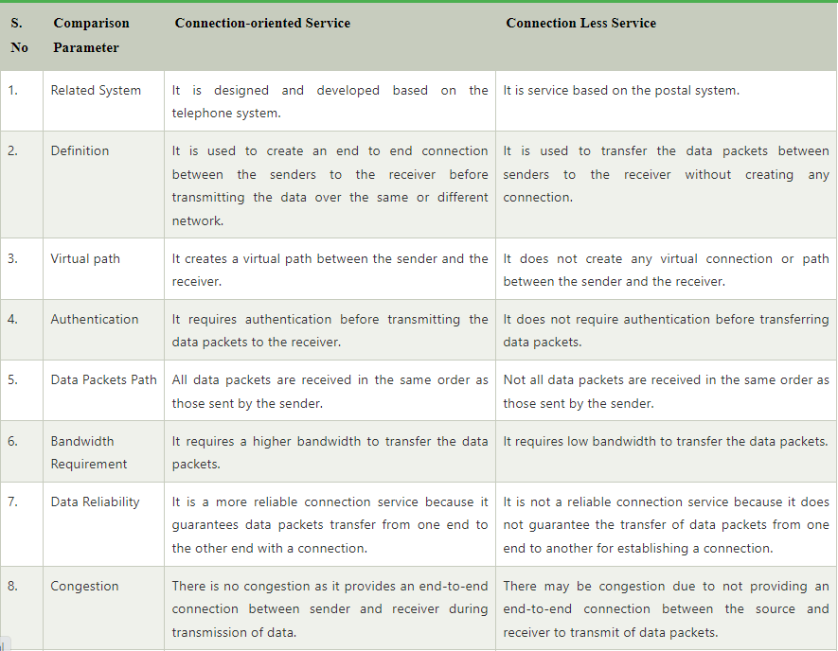

Slide 32
Physical Media

Slide 33
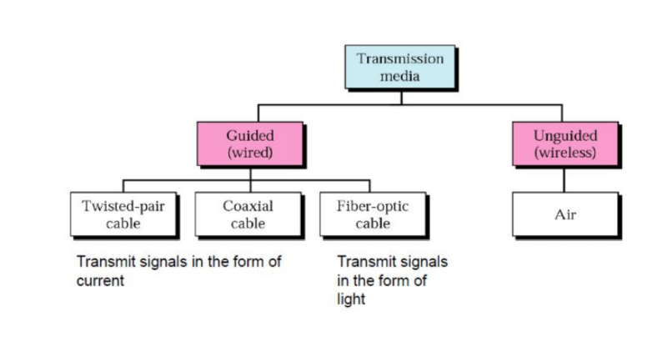

Slide 34
Twisted pair
Twisted pair is a physical media made up of a pair of cables twisted with each other.
A twisted pair cable is cheap as compared to other transmission media.
Installation of the twisted pair cable is easy, and it is a lightweight cable.
The frequency range for twisted pair cable is from 0 to 3.5KHz.
A twisted pair consists of two insulated copper wires arranged in a regular spiral pattern

Slide 35
Unshielded twisted pair
An unshielded twisted pair is widely used in telecommunication. Following are the categories of the unshielded twisted pair cable:
Category 1: Category 1 is used for telephone lines that have low-speed data.
Category 2: It can support upto 4Mbps.
Category 3: It can support upto 16Mbps.
Category 4: It can support upto 20Mbps. Therefore, it can be used for long-distance communication.
Category 5: It can support upto 200Mbps.
Advantages Of Unshielded Twisted Pair:
It is cheap.
Installation of the unshielded twisted pair is easy.
It can be used for high-speed LAN.
Disadvantage:
This cable can only be used for shorter distances because of attenuation.

Slide 36
Shielded Twisted Pair
A shielded twisted pair is a cable that contains the mesh surrounding the wire that allows the higher transmission rate.
Characteristics Of Shielded Twisted Pair:
The cost of the shielded twisted pair cable is not very high and not very low.
An installation of STP is easy.
It has higher capacity as compared to unshielded twisted pair cable.
It has a higher attenuation.
It is shielded that provides the higher data transmission rate.
Disadvantages
It is more expensive as compared to UTP and coaxial cable.
It has a higher attenuation rate.

Slide 37
Coaxial Cable

Slide 38
Fibre Optic
Fibre optic cable is a cable that uses electrical signals for communication.
Fibre optic is a cable that holds the optical fibres coated in plastic that are used to send the data by pulses of light.
The plastic coating protects the optical fibres from heat, cold, electromagnetic interference from other types of wiring.
Fibre optics provide faster data transmission than copper wires.

